Slide 1
Physics behind horseback riding
By: Bri Lamora, Mckinzie Simon, Traci Smith, Ashley Archuleta

Slide 2
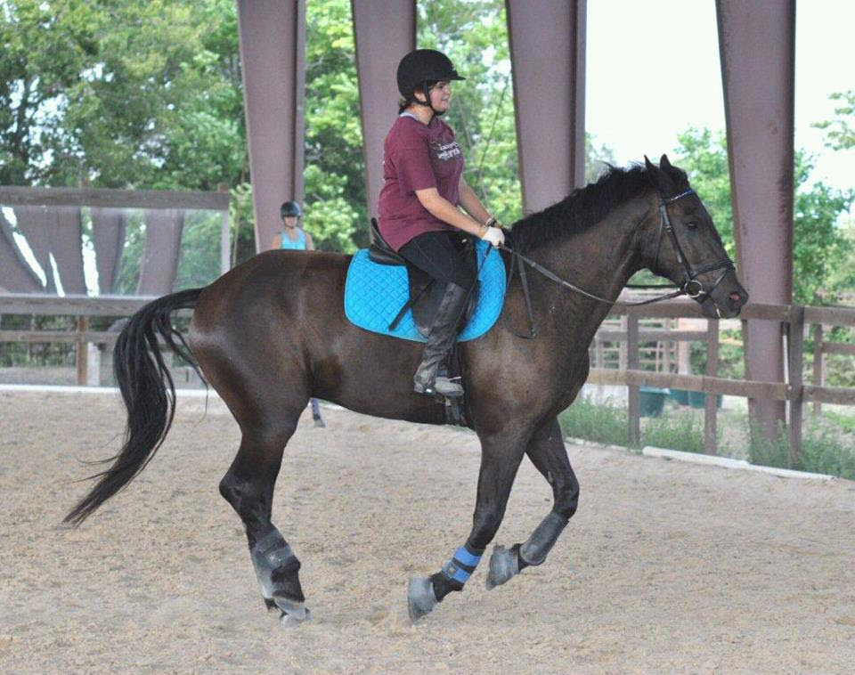
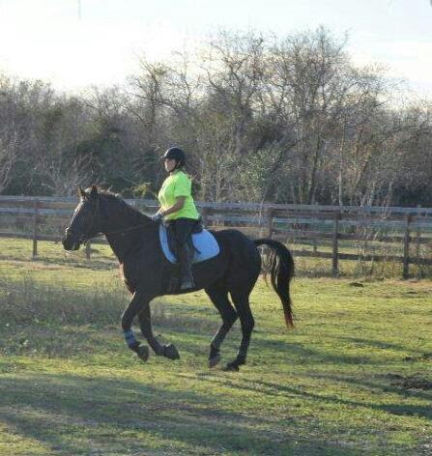
Momentum behind horseback riding
Momentum: force or speed of movement.
Can be used to predict the resulting direction of objects after they collide.
As the horse begins to move, the momentum begins to increase and the horse’s acceleration increases.

Slide 3
Videos
http://www.cleanvideosearch.com/media/action/yt/watch?videoId=8zY9_FD7e7U 1:18
http://www.cleanvideosearch.com/media/action/yt/watch?videoId=7ZzWccM_5cM 40 sec
http://www.cleanvideosearch.com/media/action/yt/watch?videoId=u4fJeXsRx5w

Slide 4
Newton's 3rd Law
Newton’s 3rd Law: For every action there is an equal and opposite reaction.
As the horse is galloping, it is pushing on the ground and the ground is pushing back.
If the horse doesn’t make the jump completely its leg will hit the poles and the pole will fall.

Slide 5
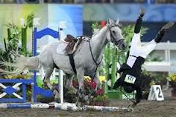

Slide 6
Kinetic and Potential Energy
Kinetic Energy: the kinetic energy of an object is the energy which it possesses due to its motion.
The horse has the greatest kinetic energy when the horse lands after the jump.
Potential Energy: potential energy is energy stored in a system of forcefully interacting physical entities.
The horse only has potential energy after the takeoff and has the greatest potential energy at the highest point of the jump.

Slide 7
