Slide 1
Unit 10: Magnetism
Pre-AP Physics

Slide 2
Part 1: Magnetic Fields

Slide 3
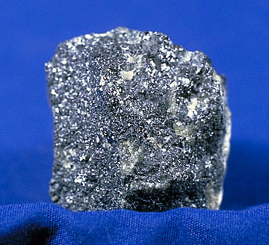
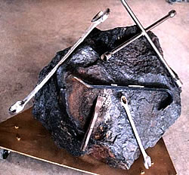
Origins
The word “magnet” is derived from the Ancient Greek region of Magnesia.
The Greeks discovered magnetic stones containing a mineral that was named “magnetite”. Magnetite is a special type of iron ore.

Slide 4
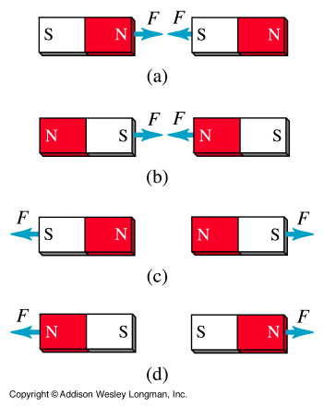
Magnets
Magnets have two poles: a North Pole and a South Pole.
Opposite poles attract (N & S) and like poles repel (N & N or S & S)
The magnetic force is indirectly proportional to the distance between the magnets.
As distance decreases, the force increases.
Because every magnet has only two poles, it is referred to as a magnetic dipole.

Slide 5
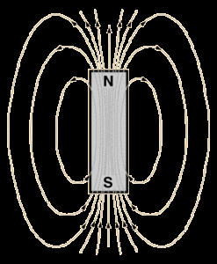
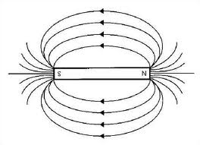
Magnetic Field
The 3-dimensional region around a magnet where it can exert a force on other magnets.
Drawn as field lines which are always directed away from the North pole and toward the South pole.
The symbol for a magnetic field is “B”.
The strength (magnitude) of a magnetic field is measured in Tesla (T) or Gauss (G).

Slide 6
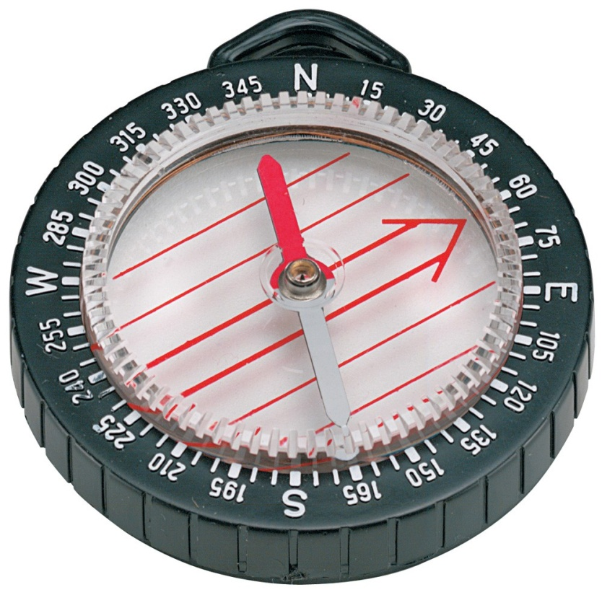
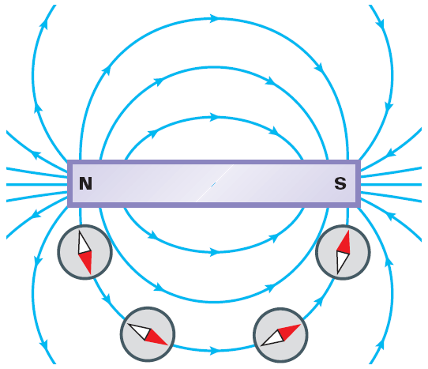
The Compass
A compass needle is a small magnet with the North end acting as the “point”.
A compass needle will always line up parallel to the direction of the magnetic field at any point around a magnet.

Slide 7
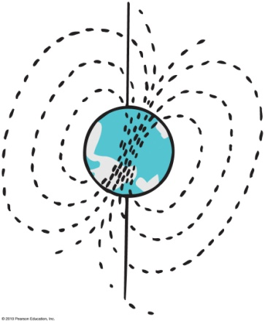
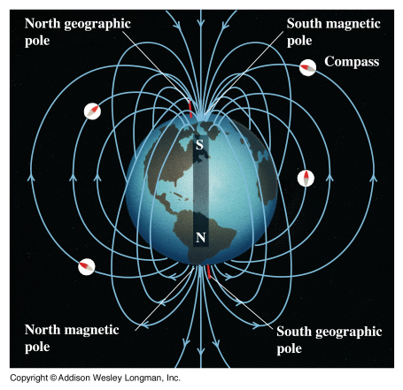
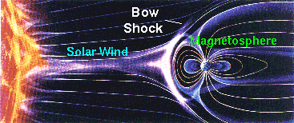
Earth’s Magnetic Field
The magnetic field of the Earth is generated by the motion of the liquid metal outer core.
It is called a geodynamo.
The geographic North pole is actually the magnetic South pole, and vice versa.
The Earth’s magnetic field is important because it protects us from the solar wind.

Slide 8
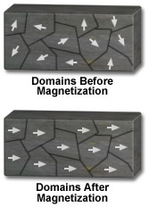
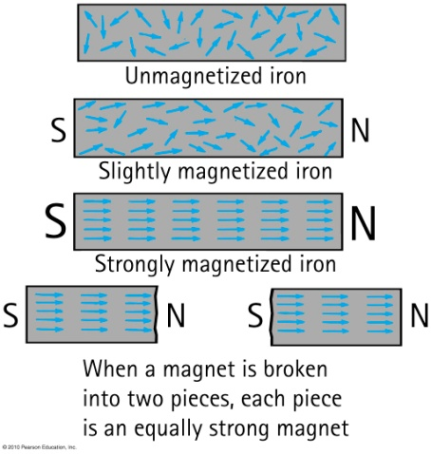
Magnetic Domains
A region of atoms in a material that have uniform magnetic fields.
An object is magnetized if the domains are aligned.
It is unmagnetized if the domains are all pointing in random directions because the fields cancel out.
In a permanent magnet the domains are always aligned.

Slide 9
Part 2: Magnetic Forces

Slide 10
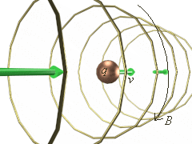
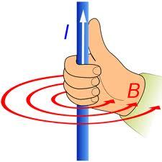
Fields generated by Electric Charges
Moving charges generate magnetic fields.
A current-carrying wire has a magnetic field around it.
The field is perpendicular to the direction of current flow.
The direction of the field is determined by the 1st Right-Hand-Rule.
The right thumb is pointed in the direction of the conventional current.
The four fingers point in the direction of the magnetic field.
Reminder: Conventional current is the flow of positive charge!

Slide 11
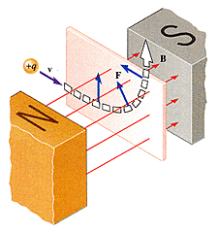
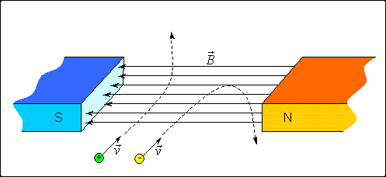
Force on a Moving Charge in a Magnetic Field
If a charged particle is moving perpendicular to an external magnetic field, it will feel a force.
This is because the charge has generated its own internal magnetic field.
Requirements in order for a force to be exerted:
The object must have a charge.
The charge must be moving.
It’s velocity must be perpendicular to the magnetic field.
The force is perpendicular to the motion of the charge and will cause it to move in a circular path.

Slide 12
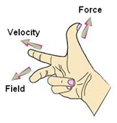
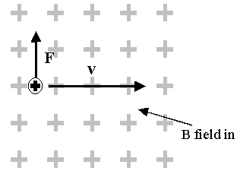
2nd Right Hand Rule
The direction of the force on a positive charge is determined by the 2nd Right Hand Rule.
The hand is held with the pointer, middle finger, and thumb held out perpendicular to one another, as in the diagram.
The pointer finger is held in the direction of the velocity of the charge.
The middle finger is held in the direction of the magnetic field.
The thumb shows the direction of the force that is exerted on the charge.
Remember that this is only for positive charges!
What if the charge is negative?
Use your left hand!
Or use your right hand and reverse the direction of the force!
A “dot” represents a vector that is coming out of the page, and a “X” represents a vector that is going into the page.

Slide 13
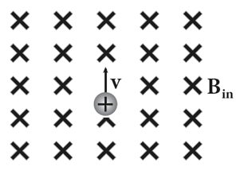
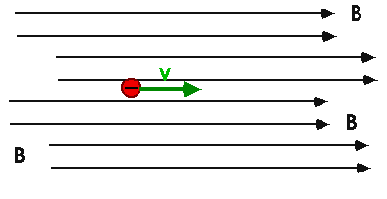
Example 1
Use the 2nd Right Hand Rule to determine the direction of the force acting on each charge below.
Solution:
F
The force is directed to the left (-x)
There is no force.

Slide 14
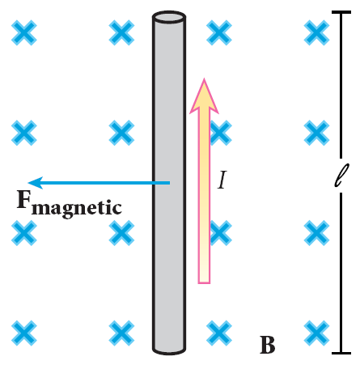
Force on a Current-Carrying Wire in a Magnetic Field
Charges moving in a wire will also feel a force when placed in an external magnetic field.
This is because the wire generates its own internal magnetic field.
The direction of the force on the wire is determined by the same 2nd Right Hand Rule
The direction of the “velocity” of the charge is replaced with the direction of the conventional current.
Remember: “conventional” current is the flow of positive charge.

Slide 15
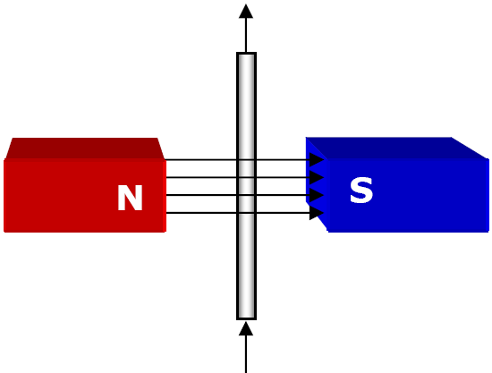
Example 2
A wire is placed in a magnetic field that is directed to the right (+x). The electric current in the wire is directed upward (+y). What is the direction of the force exerted on the wire?
Solution:
The force is directed into the page (-z)

Slide 16
How is the magnitude of the magnetic force calculated?
Equation for a single charge moving in a magnetic field:
F_{B} : magnetic force magnitude (in Newtons)
q : magnitude of charge (in Coulombs)
v : velocity of charge (in m/s)
B : external magnetic field strength (in Tesla)
Remember: only the perpendicular components of the velocity and magnetic field go in the equation!
Equation for a current-carrying wire:
F_{B} : magnetic force magnitude (in Newtons)
I : amount of electric current (in Amperes)
L : length of wire in magnetic field (in meters)
B : external magnetic field strength (in Tesla)
Remember: only the perpendicular components of the length and magnetic field go in the equation!

Slide 17
Example 3
A proton (with a charge of +1.6x10⁻¹⁹ C) traveling at 3,600 m/s inward (-z) enters a magnetic field of 0.750 Tesla directed to the left (-x). What is the magnitude and direction of the force exerted on the proton?
Solution:
Draw a sketch of the situation.
Apply the formula F_{B} = qvB
So F_{B} = (1.6x10⁻¹⁹)(3,600)(0.75) = 4.32x10⁻¹⁶ N
F_{B} = 4.32x10⁻¹⁶ N, upward (+y)
B is in the –x direction and v is in the –z direction. Using the 2nd Right Hand Rule, the direction of the force must be upward (+y).
F
v
B

Slide 18
Example 4
An electron (with a charge of -1.6x10⁻¹⁹ C) is moving at 2.1 km/s to the right (+x) when it enters a magnetic field and experiences 1.25x10⁻¹⁶ Newtons of Force acting on it in the -z direction. What is the magnitude and direction of the magnetic field?
Solution:
Draw a sketch of the situation.
Apply the equation F_{B} = qvB
Rearrange to solve for B. so B = F_{B} / (qv)
So B = (1.25x10⁻¹⁶) / [(1.6x10⁻¹⁹)(2,100)] = 0.372 T B = 0.372 Tesla, upward (+y)
V is to the right (+x) and FB is into the page (-z). According to the Right Hand Rule for the left hand (negative charge), the field must be directed upward (+y).
F
v
B

Slide 19
Example 5
A 3.5 meter section of wire is placed horizontally in a magnetic field that is directed in the +z direction and has a magnitude of 1.35 T. How much current (and in what direction) is required in order for the wire to feel a downward force of 27.2 Newtons?
Solution:
Draw a sketch of the situation.
Apply the equation F_{B} = ILB
Rearrange to solve for I, so I = F_{B} / (LB)
I = (27.2) / [(3.5)(1.35)] = 5.76 A
I = 5.76 A, to the right (+x)
According to the 2nd Right Hand Rule, the current must be directed to the right (+x)
B
I
F
L = 3.5 m

Slide 20
Part 3: Electromagnetism

Slide 21
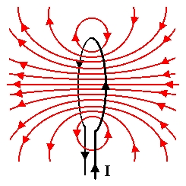
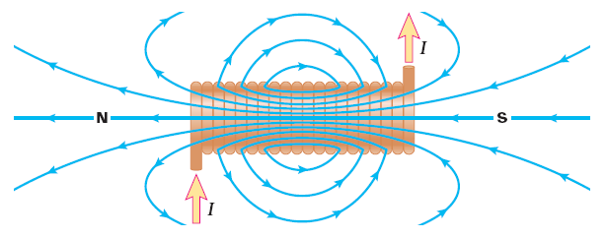
Magnetic Field of a Current Loop
A current carrying wire can be bent into a loop.
The right hand rule still determines the direction of the magnetic field.
If the wire is wound into many loops it then becomes a solenoid.
The number of loops multiplies the strength of the magnetic field.

Slide 22
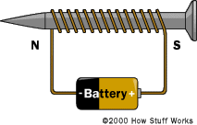
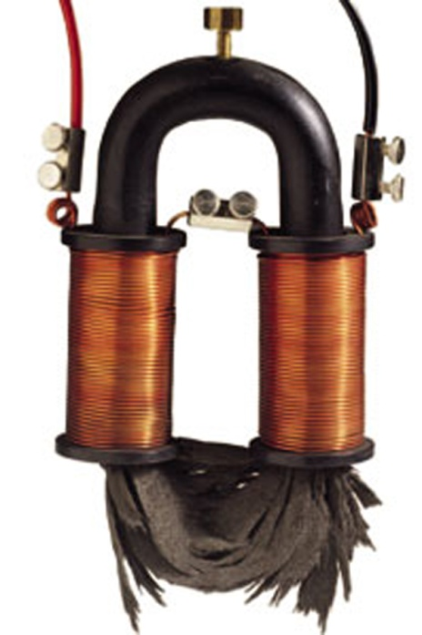
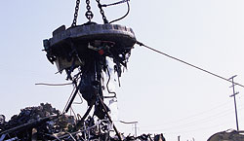
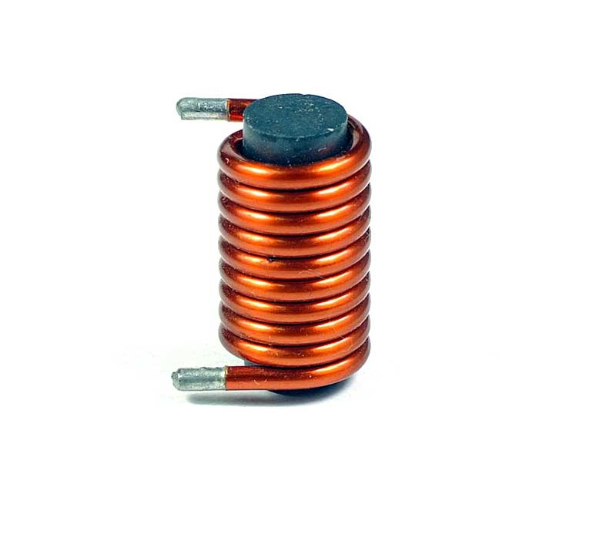
Electromagnets
Placing an iron core into a solenoid turns it into an electromagnet.
This greatly increases the strength of the magnetic field because the magnetic domains of the iron will align and contribute to the field.

Slide 23
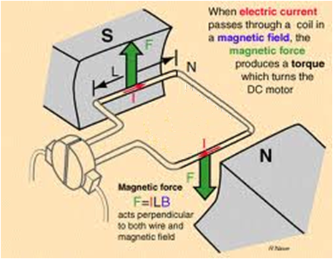
Electric Motors
An electric motor converts electrical energy into mechanical energy.
A current-carrying loop of wire is placed into a magnetic field. Each side of the loop feels a force, causing the loop to turn.

Slide 24
Part 4: Electromagnetic Induction

Slide 25
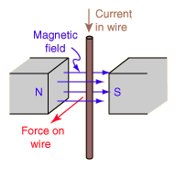
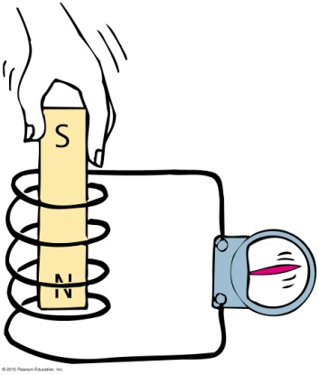
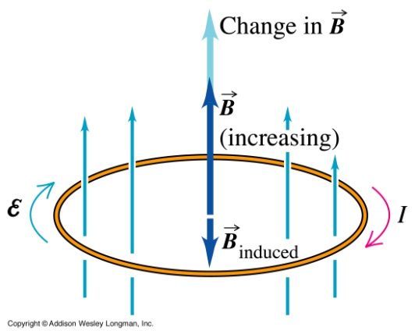
Electromagnetic Induction
In electromagnetism we learned that electric currents generate magnetic fields.
It is also possible for magnetic fields to generate electric current in a conductor. This is called electromagnetic induction.
Current is induced in a conductor when there is relative motion between the conductor and the magnetic field.
Moving a wire inside of a magnetic field.
Moving a magnet through a loop of wire.
Changing the strength of the external magnetic field.

Slide 26
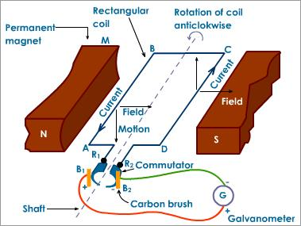
Electric Generators
An electric generator converts mechanical energy into electrical energy.
It is basically an electric motor in reverse.
A force is applied to turn a loop of wire inside a magnetic field. This generates an electric current in the wire.

Slide 27
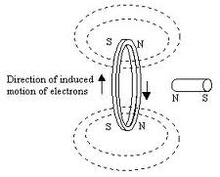
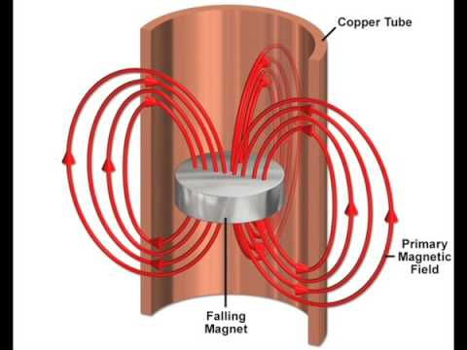
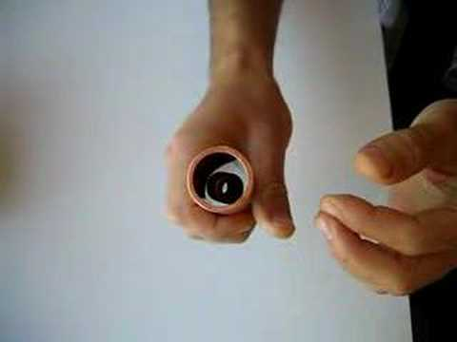
Lenz’s Law
Lenz’s Law states that the induced current will generate its own internal magnetic field that opposes the original external magnetic field.
This causes a resistive force.
When dropping a magnet through a copper tube, this generates eddy currents which slow the magnet as it falls.

Slide 28
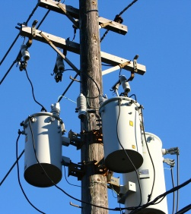
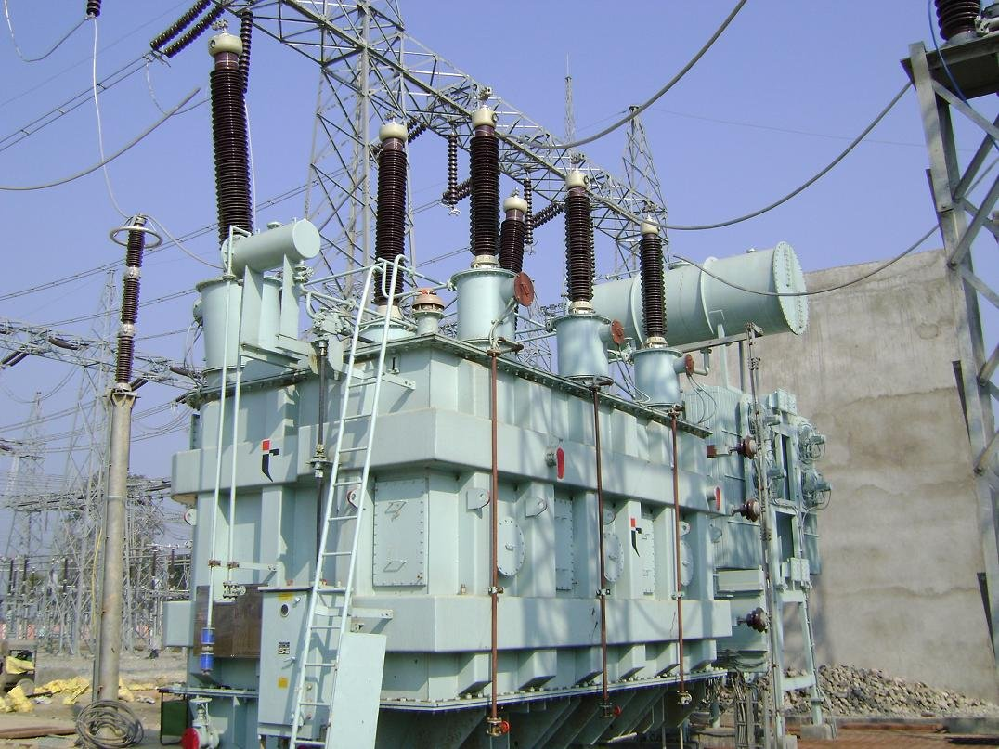
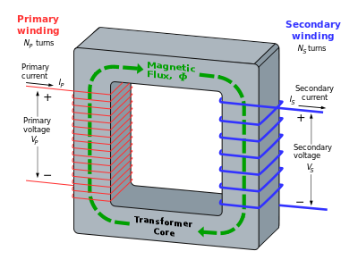
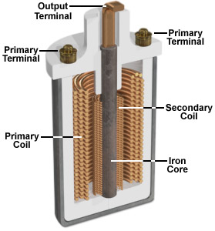
Transformers
A transformer is a device that “steps up” or “steps down” voltage in a power line.
Many loops of the “primary” wire are wrapped around an iron core. When current runs through the wire it generates a magnetic field in the iron core.
A “secondary” wire is wound around the other side of the core with a different number of loops. The magnetic field caused by the primary induces a current in the secondary wire.
The ratio of the number of primary loops to secondary loops determines the factor by which the voltage is changed.
2x as many loops = 2x the voltage
½ loops = ½ the voltage
1000x as many loops = 1000x the voltage

Slide 29
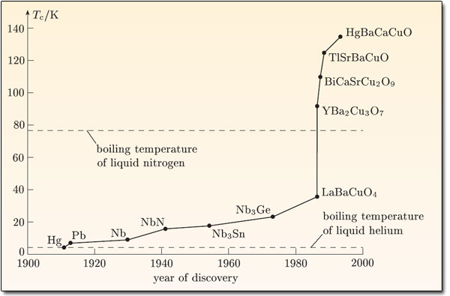
Superconductors
A superconductor is a material with zero electrical resistance.
The temperature at which something becomes a superconductor is called the critical temperature, and is usually very low.
High temperature superconductors have their critical temperature above that of liquid nitrogen (-196ºC, 77 K)

Slide 30
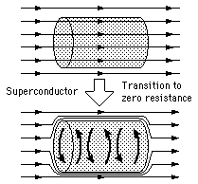
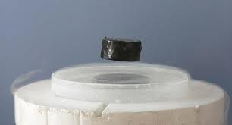
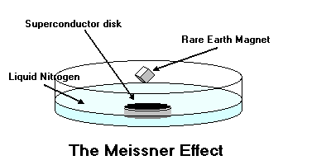
Superconductors
Superconductors have the ability to “trap” external magnetic fields. This is called the Meissner effect.
A superconductor can “lock in” the magnetic field of a magnet placed above it, causing magnetic levitation.

